Slide 1

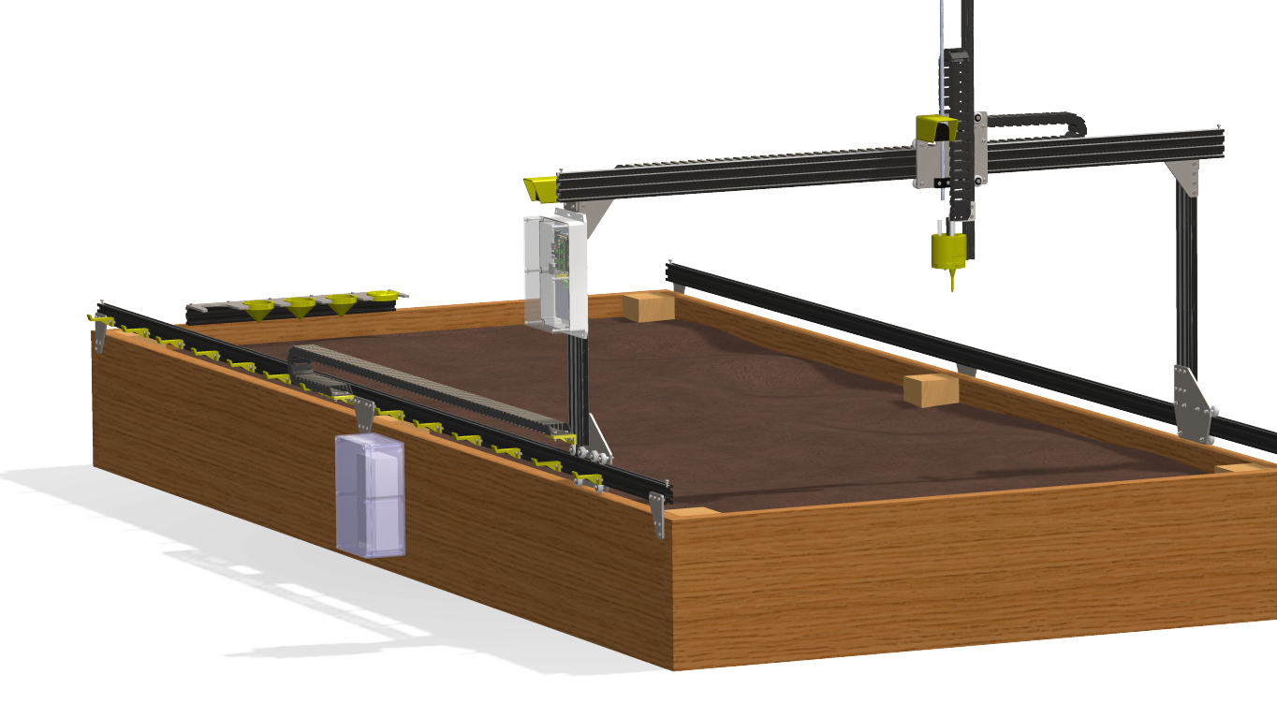
FarmBot
By: ADANEGBE AMADASUN
ALISHA SINGH CHAUHAN

Slide 2
Proposal
The Farmbot is basically CNC farming technique which has proved to be the great way for the production of small scale food. It has turned out to be a reliable and approachable source to accomplish the idea of integrating an artificial approach to take care of the cultivation.
An open source automated farming device which operates on an Arduino Mega 2560, Raspberry Pi 3, disassembled hardware packages and other software sources which could be used as seed injectors, watering nozzles, sensors etc.
Our prototype has one axis which moves back and forth when the commands are given and the stepper motor turns the belt.

Slide 3
Budget
Raspberry Pi 3 Complete Starter Kit - 32 GB Edition - $74.35
Arduino Mega - $49.95
5v Switching Power Supply - $15
Ramps 1.4 for 3D Printer – $35.95
Stepper Motor Driver - $14.25
Bipolar Stepper Motor - $29.50
Time Pulley - $9.00
Rotary - $4.95
Timing Belt - $19
SD Card: $10
Total = $294.70 + HST

Slide 4
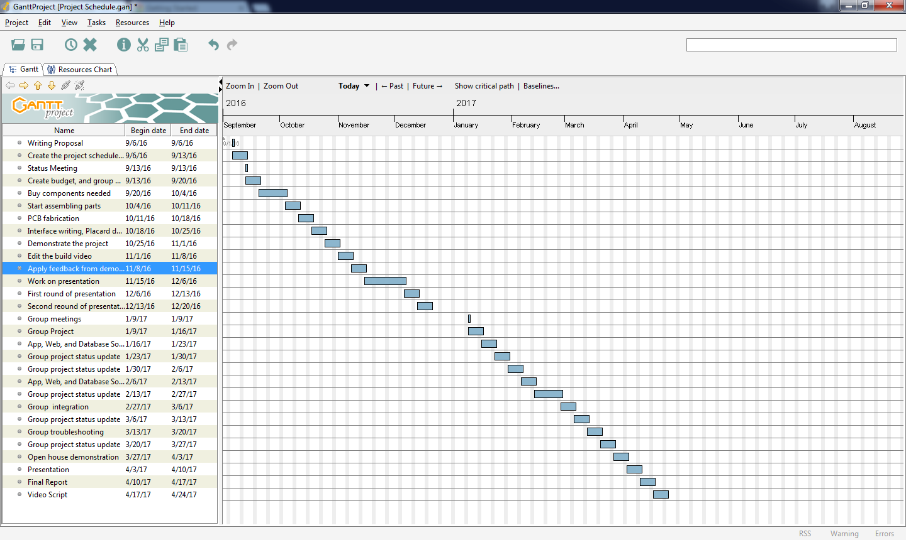
Schedule

Slide 5
Arduino Mega 2560
HARDWARE INTEGRATION
Arduino is an open-source electronics platform based on easy-to-use hardware and software.
It is capable reading inputs such as light on a sensor, or a finger on a button, and turn it into an output which can activate a stepper motor, or turn an LED on.
For our project, we used an Arduino Mega 2560 to control our bi-polar stepper motor.
On the Arduino Mega 2560, we mounted a 1.4 ramp shield, and used a DRV8825 stepper driver.
We tuned the stepper driver to allow a maximum of 0.7Amps.

Slide 6
Rather than using three axis (X,Y,Z), we used only one axis (X-axis) for our prototype.
For our stepper motor to move, we loaded it with teacup firmware and used pronterface to send commands on the distance we want it to move.
After multiple testing to determine the distance, we wrote a piece of code that will instruct the Arduino to move the stepper motor to three different positions namely: home, moisture, and water, and return back to home position.

Slide 7
SOFTWARE INTEGRATION
The Farmbot prototype uses Raspberry Pi 3 OS which ahs various inbuilt functions:
it will have a communication channel to sync with logs and sequences of data using Ethernet of Wi-Fi.
Another connection for interaction of Arduino and sensor data of G-code commands.
Farmbot App
Farmbot Arduino Controller
Gcode Processor
Stepper Control
Farmbot Raspberry pi3
Command
Handler

Slide 8
CONCLUSION
The making of this project will eliminate so many farming problems which have been faced by our technologists in the previous years.
We recommend Farmbot because of numerous reasons such as FarmBot is the first piece of technology that is an end-to-end soil-based food production system that is also 100% open source, focused on precision, controlled from the web, and accessible and appropriate for small-scale operations.
In our model, we only used one axis which moves forward because it was our first experiment so we wanted to move with simplicity but it is recommended to make other two axes as well Y-axis and Z-axis. Our project is facing issues setting up the Wi-Fi in the raspberry pi as it uses Farmbot OS.

Slide 9
Previous Courses Utilized
CENG 252 - Embedded Systems
-Provided knowledge on reading inputs from sensors.
CENG 200 - UNIX Scripting
-Provided knowledge on scripting that I used as reference when creating my Python script.
WRIT 120 – Technical Reading and Writing Skills
-Provided Knowledge on writing proposals and progress report
CENG 216 – Introduction to Software Engineering
-Provided knowledge on creating schedule with gnat chart
CENG 253 – Network Technologies
-Provided help regarding routing

Slide 10
VIDEO
https://www.kizoa.com/Movie-Maker/d108230515k2507861o1/movie

Slide 11


